Slide 1

MIND SPIRIT 2025
TITLE PAGE
SHE SKILLS
Empowering Women Through Talent, Safety & Opportunity
Theme : Femine Shakti(Women Empowerment)
App Category: Software
Team Name: Bold Bytes
Team ID:TM-FS-016

Slide 2
PROBLEM STATEMENT
Many talented housewives skilled in tailoring, mehendi design, home cooking, beauty services, and more often remain unnoticed and undervalued due to the absence of a platform to showcase their abilities or find customers. At the same time, people looking for simple local services like blouse stitching or homemade food struggle to discover trusted, nearby women service providers . A key barrier is ensuring this connection happens without compromising women’s privacy and safety. Sharing personal phone numbers, exact home addresses, or identity details can expose women to risks and misuse . There is a strong need for a safe, women-centric, location-based platform that helps users find skilled housewives in their area while ensuring strict privacy protection, secure communication, and meaningful earning opportunities for women from the comfort of their homes.

Slide 3
SOLUTION AND UNIQUENESS
PROPOSED SOLUTION
To build SheSkills, a safe and women-centric local skill discovery platform for talented housewives
Showcase their skills
Financial independence
Approximate location
Secure, in-app communication
Privacy-protected system
UNIQUENESS
Privacy-first platform
Local discovery, not geo-tracking
Women-centric design
Secure communication
Skill-focused profiles
Simple and friendly interface
Trust-building features
Community upliftment

Slide 4
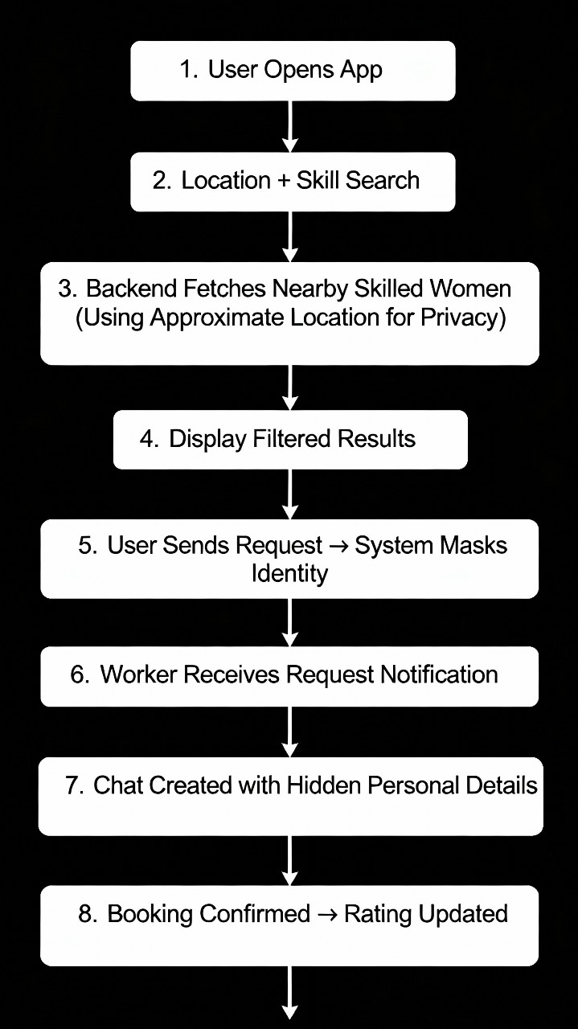
TECHNOLOGY :
Frontend : Flutter (native Android/iOS + web)
Backend : Python (FastAPI / Flask)
Database : PostgreSQL
Location & Privacy : Geohash / rounded lat-lng
Authentication & Identity : Firebase Auth (scalable)
Payments : Razorpay or Stripe India
METHODOLOGY:

Slide 5
CHALLENGES | SOLUTIONS
Women hesitate to join due to privacy risks | Mask personal details and show only approximate location
Fake or unverified worker profiles reduce trust | Use admin verification and skill sample uploads
Lack of trust between customers and workers | Add ratings, reviews, and verified badges
Women are unsure or shy to join new platforms | Provide simple onboarding and highlight success stories
Feasibility
High Demand for Local Services
Increasing Smartphone Access Among Housewives
Simple and Low-Cost Technology Stack
Easy Adoption in Urban & Semi-Urban Areas
Supports Work-From-Home Opportunities
Scalable Architecture
Strong Social Acceptance
Government & NGO Alignment

Slide 6
IMPACTS:
Creates financial independence for housewives through flexible part-time work.
Brings visibility to hidden talents in tailoring, mehendi, cooking, beauty services, etc.
Provides a safe and secure environment for women to offer services without exposing personal details.
Increases local employment opportunities within communities.
Builds trust between customers and women service providers through verified profiles and ratings.
Boosts digital participation among women who previously had limited technology exposure.
Strengthens community-level economic activity driven by women.
Encourages women empowerment, confidence, and self-reliance.
BENEFITS:
Women can earn from home without affecting their household responsibilities.
Customers get easy access to reliable, nearby women service providers.
Simple and user-friendly app helps women with low digital literacy use the platform comfortably.
Privacy-first features ensure no misuse of phone numbers or home addresses.
Ratings and reviews improve trust and service quality.
Encourages more women to become micro-entrepreneurs.
Supports national initiatives like Digital India, Skill India, and Women Empowerment missions.
Promotes a safer, community-driven local service ecosystem.

Slide 7
RESEARCH:
Studies indicate a rising demand for trusted, nearby service providers, with users preferring verified, community-based women for safety and convenience
Research shows that many skilled housewives lack earning opportunities, highlighting the need for flexible, part-time work options that fit their family responsibilities
Research emphasizes the need for privacy-first platforms to protect women from identity exposure, harassment, and misuse of personal information
Reports show increasing smartphone usage among housewives, but highlight the importance of simple, accessible UI for users with low digital literacy
REFERENCE:
Google. (2023). Geolocation and user safety guidelines. Google Developer Documentation
NITI Aayog. (2022). Women’s Economic Participation and Future of Work in India. Government of India
UN Women. (2022). Digital empowerment and financial independence for women. United Nations Publications
Nielsen Norman Group. (2021). User experience guidelines for low-literacy and first-time digital users. NN/g Research Article

